Slide 1
MEASURING EFFICIENCY OF INTERNATIONAL CRUDE OIL MARKETS: A MULTIFRACTALITY APPROACH
Harvey M. Niere
Department of Economics
Mindanao State University
Philippines

Slide 2
Fractal System
A system characterised by a scaling law with a fractal, i. e., non-integer exponent.
Fractal systems are characterised by self-similarity, i. e., a magnification of a small part is statistically equivalent to the whole.
(Kantelhardt 2008)

Slide 3
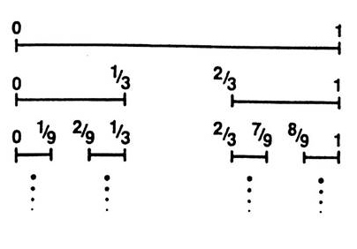
Fractals

Slide 4
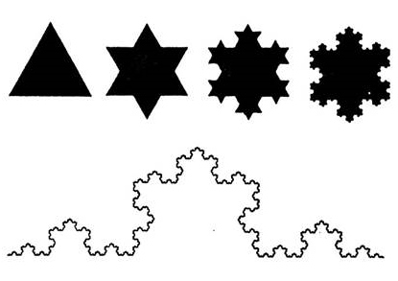
Fractals

Slide 5
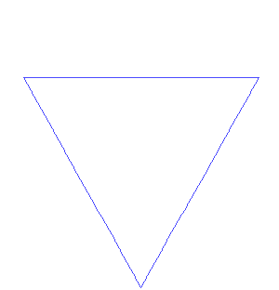
Koch Snowflakes

Slide 6
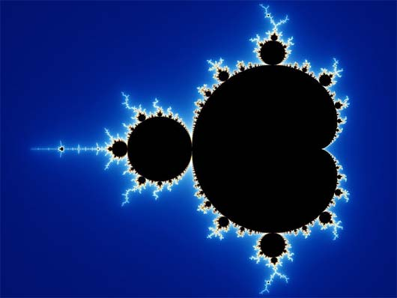
Iterated Function Systems:
$$z_{n+1}=z_{n}^{2}+c$$
Mandelbrot set

Slide 7
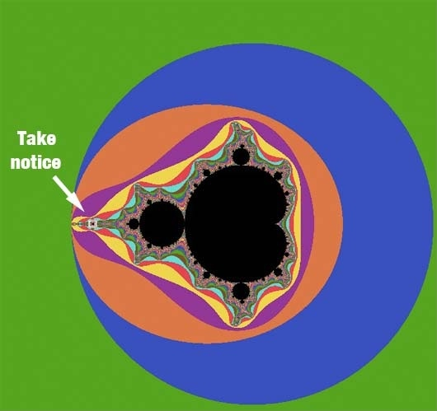

Slide 8
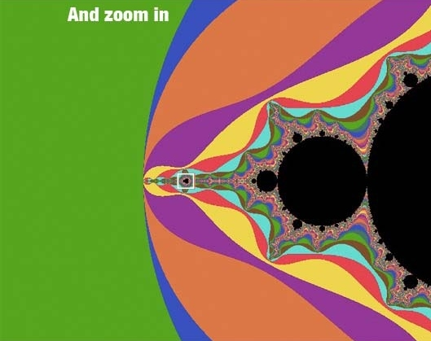

Slide 9
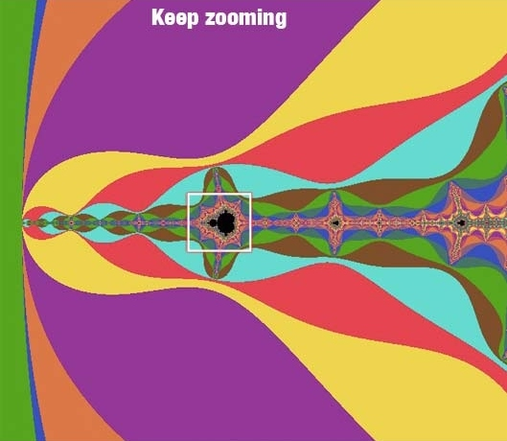

Slide 10
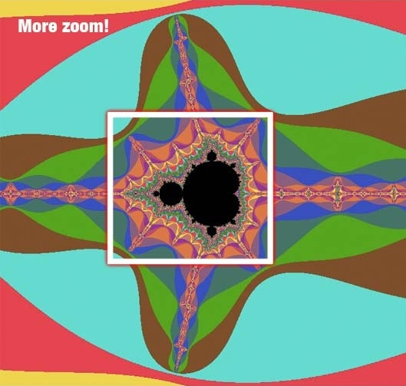

Slide 13
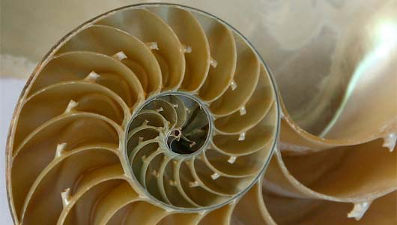
sea shells

Slide 14
lightning

Slide 15
trees

Slide 16
leaves

Slide 17
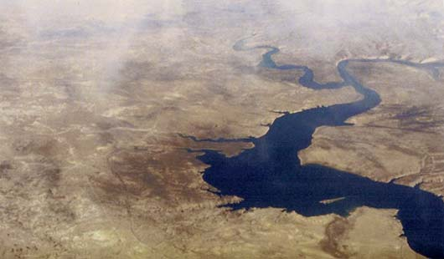
rivers

Slide 18
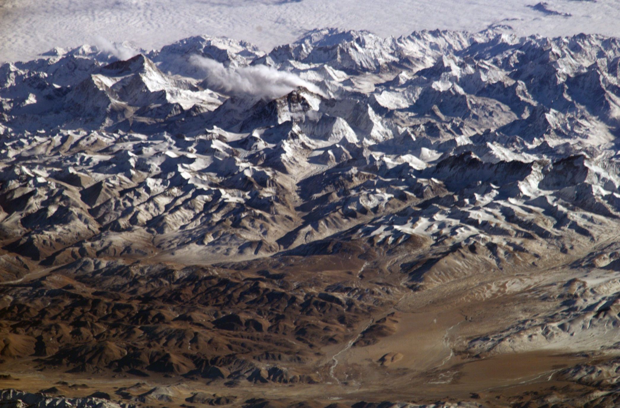
mountain ranges

Slide 20
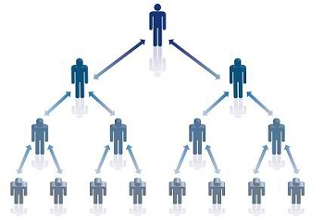
multi-level marketing

Slide 21
time series data

Slide 22
Multifractal System
A system characterised by scaling laws with an infinite number of different fractal exponents. The scaling laws must be valid for the same range of the scale parameter.
(Kantelhardt 2008)

Slide 23
Multifractal System
According to Zunino et al. (2008), multifractality can be due
long-range correlations or
broad fat-tail distributions

Slide 24
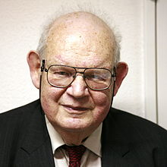
Multifractal System
Mandelbrot (1997) introduced multifractal models to study economic and financial time series in order to address the shortcomings of traditional models such as fractional Brownian motion and GARCH processes which are not appropriate with the stylized facts of the said time series such as long-memory and fat-tails in volatility.

Slide 25
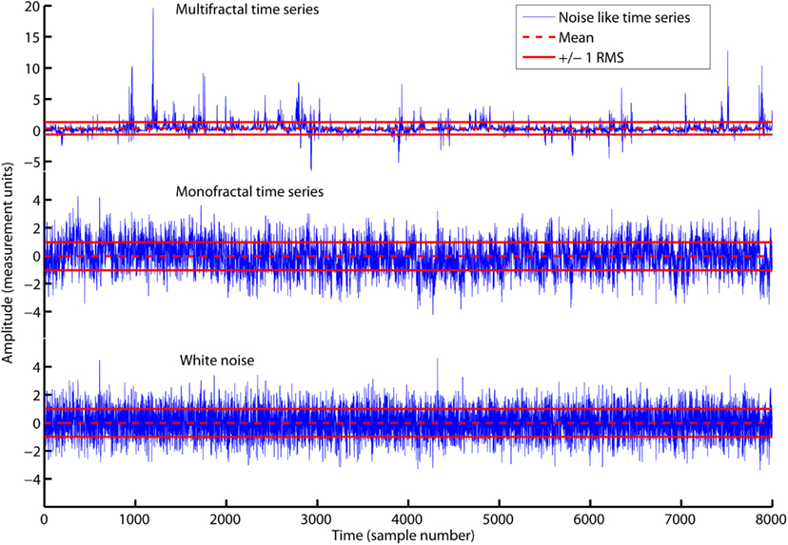
Ihlen (2012)

Slide 26
Fractals, Multifractals and Hurst Exponent
For fractals, the Hurst exponent,h, is constant.
Ordinary Brownian motion, h = 0.5
Fractional Brownian motion, 0 < h < 1
For multifractals, the Hurst exponent is not constant but is dependent with the order of fluctuation function, q.
In this case, h(q), is known as the generalized Hurst exponent.
If q = 2, then h(2) = h.

Slide 27
Market Efficiency
This refers to the degree in which the price reflects the all the available information about the asset.
If the market is efficient, then the price movement follows a random walk behavior.
In this case, the price movement is just an ordinary Brownian motion with h = 0.5.

Slide 28
Methodology
The study uses the method of Multifractal Detrended Fluctuation Analysis (MFDFA). Following Kantelhardt et al. (2002), the procedure is summarized in the following steps.
Given a time series $u_{i}$, $i$ = $1$, … , $N$, where $N$ is the length, create a profile
$Y\left(k\right)= \sum_{i=1}^{k}{(u_{i}−\overline{u}})$,
k = $1$, … , N, where $\overline{u}$ is the mean of $u$.
Divide the profile $Y\left(k\right)$ into $N_{s}=N/s$ non-overlapping segment of length $s$. Since $N$ is not generally a multiple of $s$, in order for the remainder part of the series to be included, this step is repeated starting at the end of the series moving backwards. Thus, a total of ${2N}_{s}$ segments are produced.

Slide 29
Methodology
Generate $Y_{s}\left(i\right)=Y_{s}\left[\left(v−1\right)s+i\right]$ for each segment $v$ = $1$, … , $N_{s}$, and$Y_{s}\left(i\right)=Y_{s}\left[N−\left(v−N_{s}\right)s+i\right]$ for each segment $v$ = $N_{s}+1$, … , ${2N}_{s}$.
Compute the variance of $Y_{s}\left(i\right)$ as
$F_{s}^{2}\left(v\right)=\frac{1}{s}\sum_{i=1}^{s}{{\left[Y_{s}\left(i\right)−Y_{v}\left(i\right)\right]}^{2}}$,
where $Y_{v}\left(i\right)$ is the $m^{th}$order fitting polynomial in the $v^{th}$ segment.
Obtain the $q^{th}$ order fluctuation function by
$F_{q}\left(s\right)={\left\{\frac{1}{{2N}_{s}}\sum_{v=1}^{{2N}_{s}}{{\left[F_{s}^{2}\left(v\right)\right]}^{q/2}}\right\}}^{1/q}$.

Slide 30
Methodology
For multifractals, $F_{q}\left(s\right)$ is distributed as power laws, $F_{q}\left(s\right)$ ~ $s^{h\left(q\right)}$.
The exponent $h\left(q\right)$ is called as the generalized Hurst exponent. Zunino et al. (2009) shows that he degree of multifractality can be quantified as $\left|∆h\right|=h\left(q_{min}\right)−h\left(q_{max}\right).$
The higher the degree of multifractality, the lower the market efficiency.

Slide 31
Methodology
To identify whether the multifractality is due to long-range correlations or is due to broad fat-tail distributions, shuffled data and surrogated data are generated.
100 different shuffled time series and surrogated time series are produced to reduce statistical errors.
Shuffling the data will remove the long-range correlation in the time series.
It is done by randomizing the order of the original data.
The multifractality due to long-range correlation can be computed as $h_{c}=∆h−{∆h}_{f}$ where the index $f$ refers to shuffled data.

Slide 32
Methodology
Surrogated data is produced by randomizing the phases of original data in Fourier space.
This will make the data to have normal distribution.
The multifractality due to broad fat-tail distributions can be measured as $h_{d}=∆h−{∆h}_{r}$ where the index $r$ refers to surrogated data.

Slide 33
Methodology
In conducting MFDFA, $m=3$ is used as the order of polynomial fit in Step 4.
The length $s$ varies from 20 to $N/4$ with a step of 4 as suggested in Kantelhardt et al. (2002).
Finally, $q$ runs from –10 to 10 with a step of 0.5.

Slide 34
Data
The daily prices of Brent crude, OPEC reference basket and West Texas Intermediate (WTI) crude from January 2, 2003 to January 2, 2014 are used.
The number of observations are 2788, 2839 and 2765 for Brent crude, OPEC reference basket and West Texas Intermediate (WTI) crude respectively.
The data for Brent crude and West Texas Intermediate (WTI) crude are downloaded from the US Energy Information Administration online database website: http://www.eia.gov/dnav/pet/pet_pri_spt_s1_d.htm.
The data for OPEC reference basket are downloaded from the OPEC online database website: http://www.opec.org/opec_web/en/data_graphs/40.htm

Slide 35
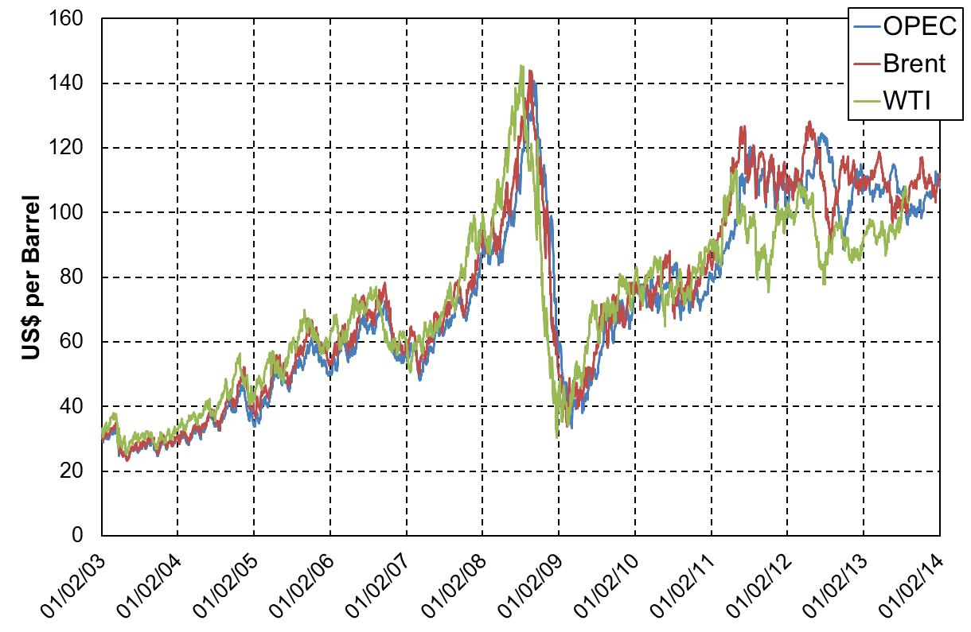

Slide 36
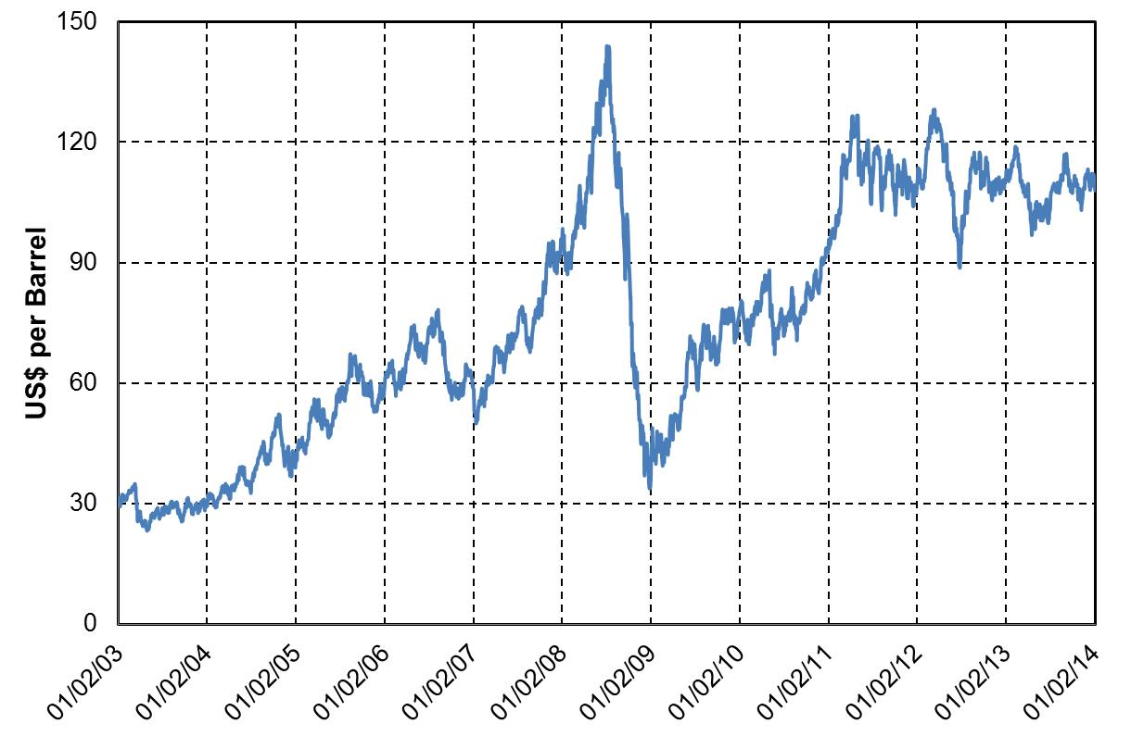
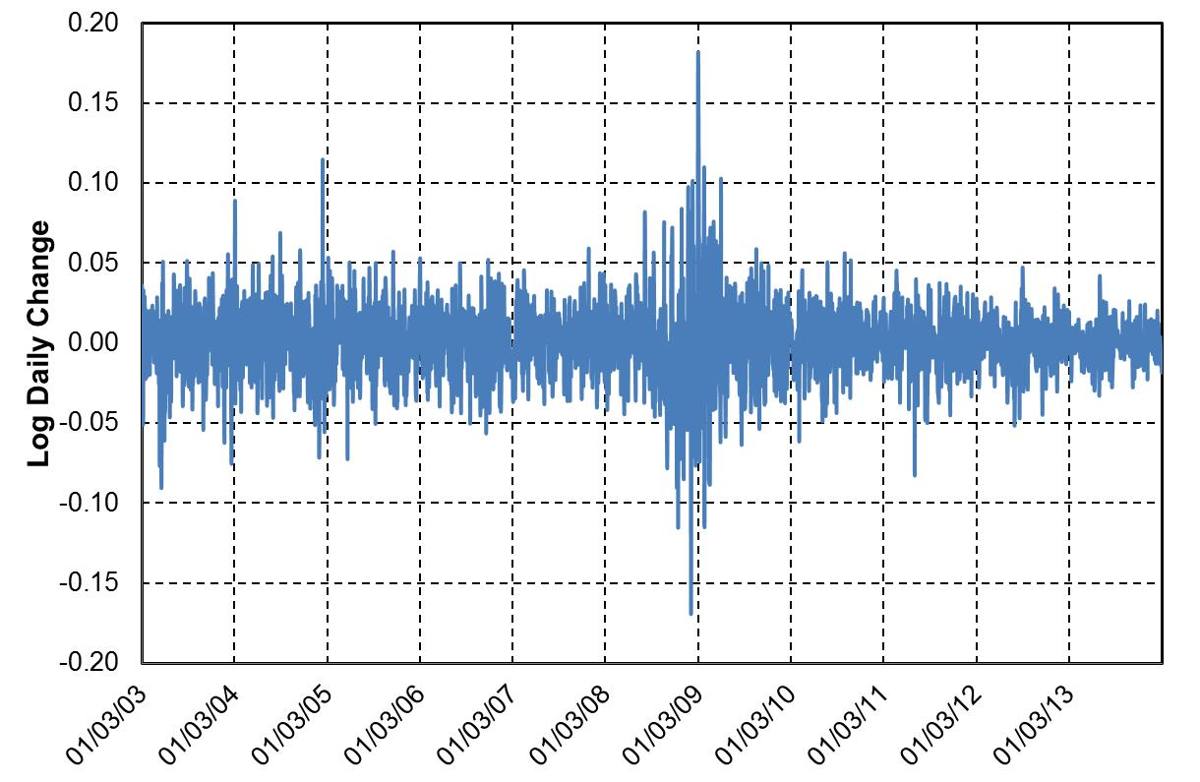
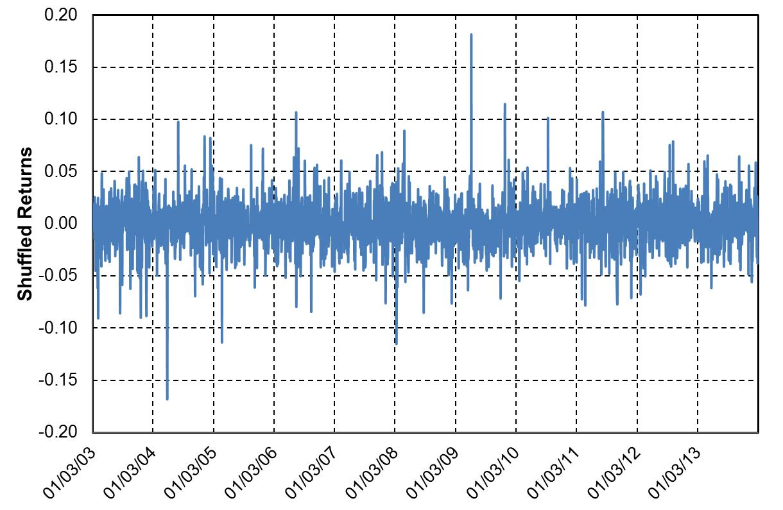
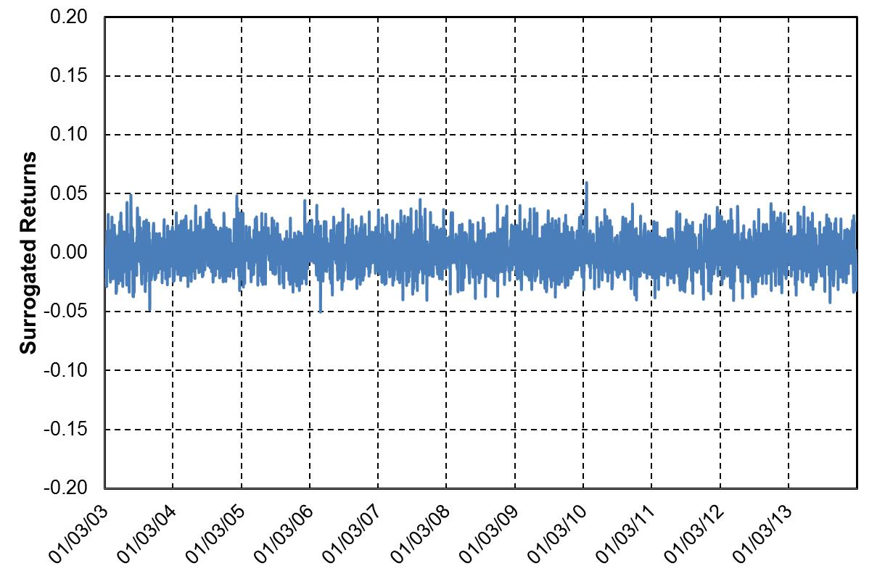
Brent Crude

Slide 37
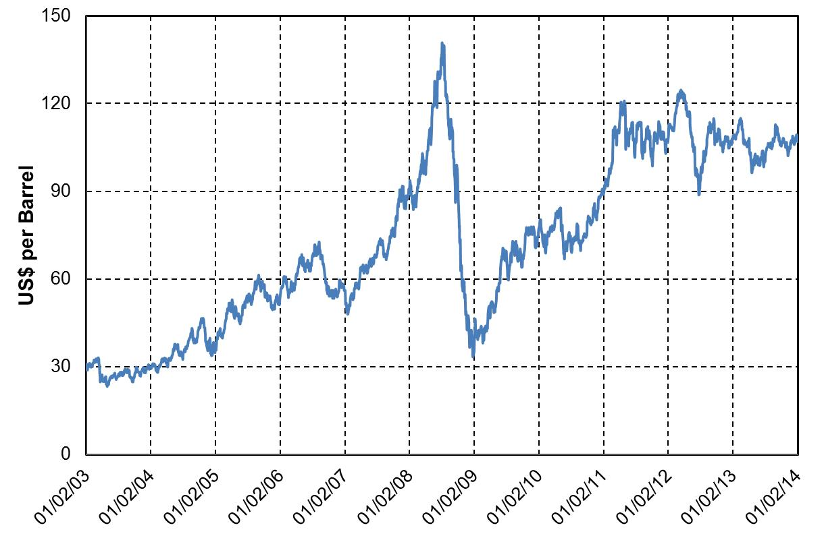
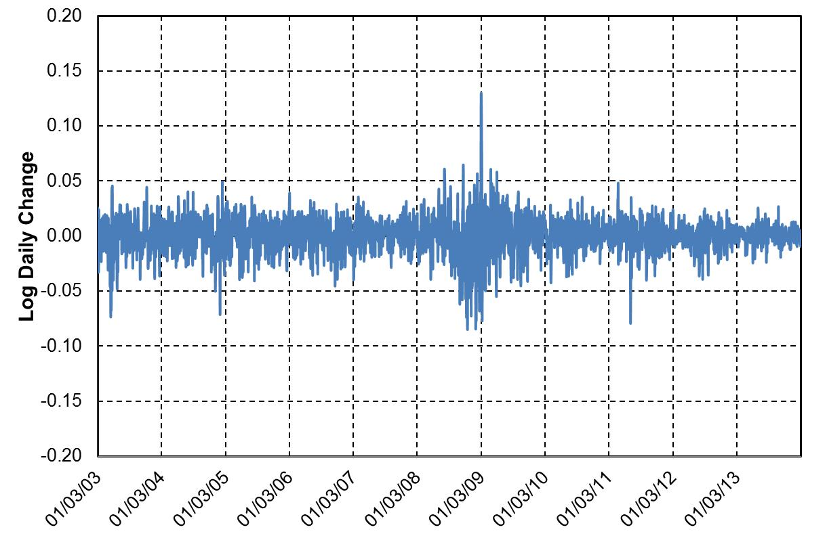
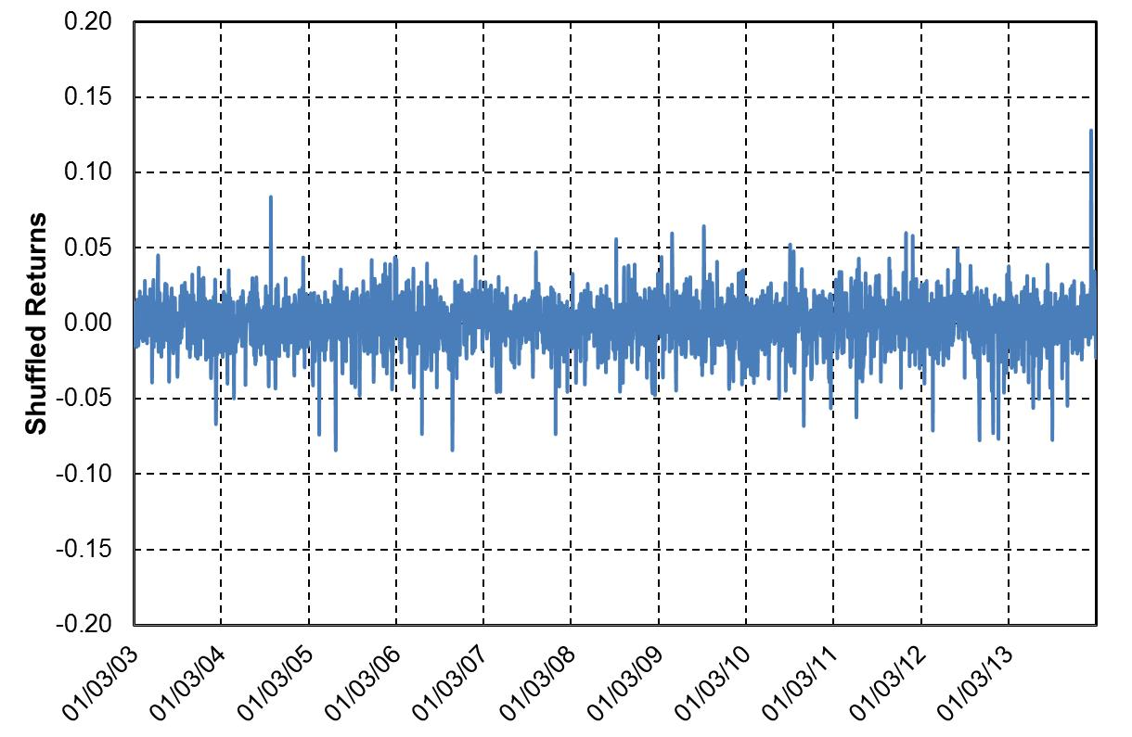
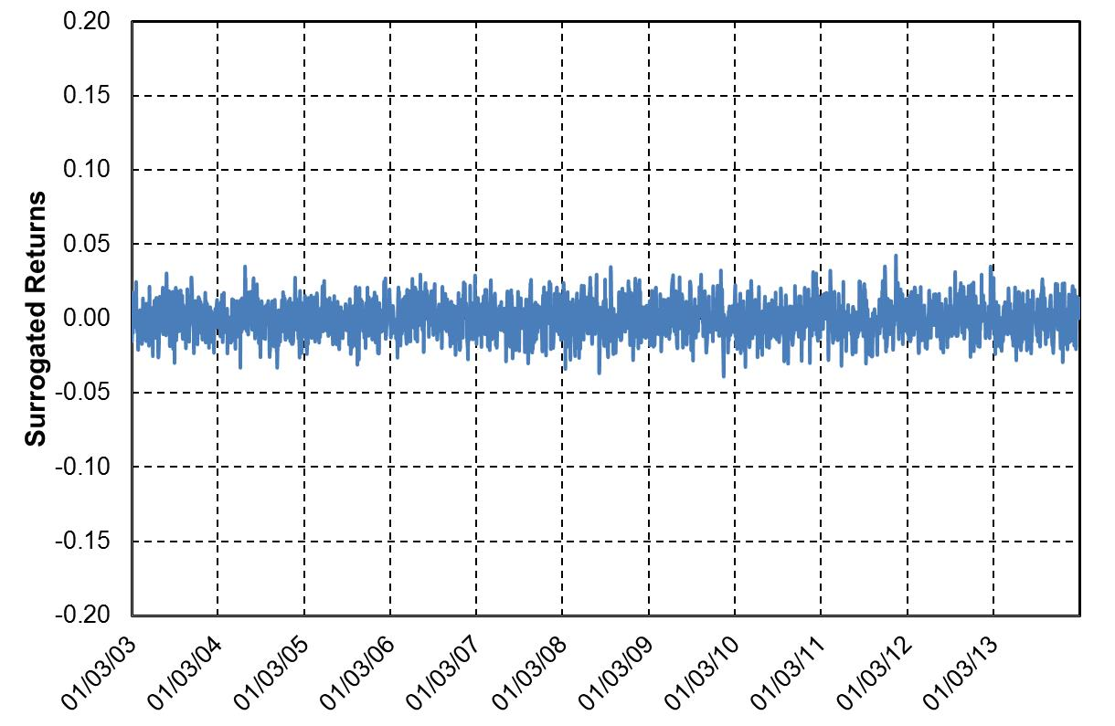
OPEC Reference Basket

Slide 38
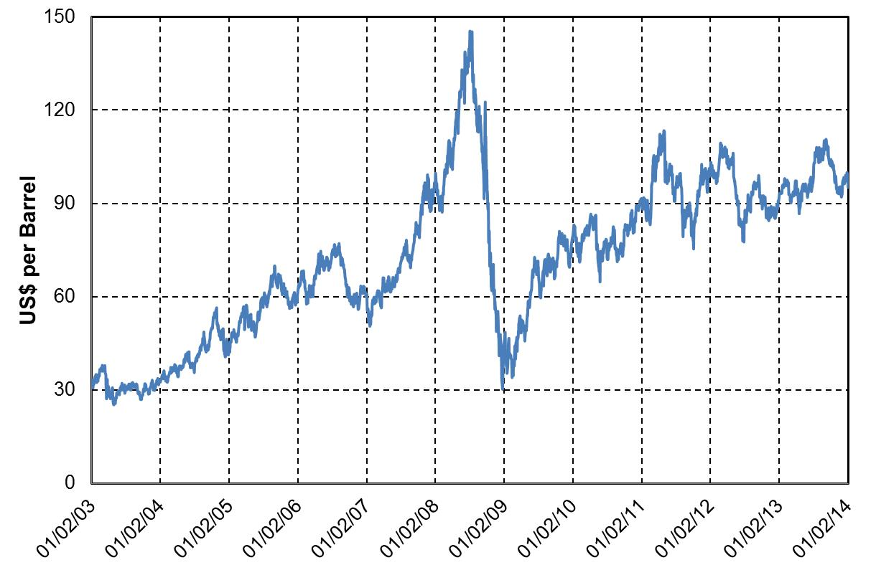
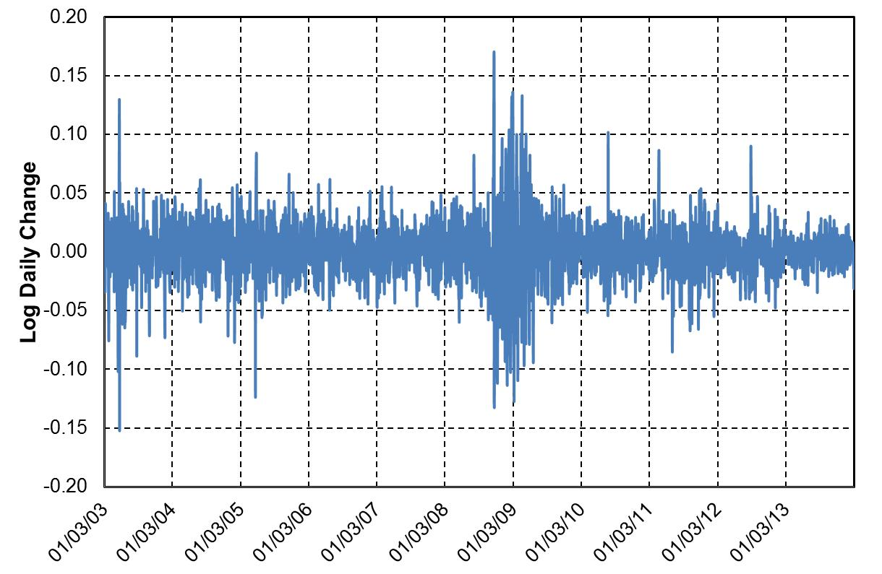
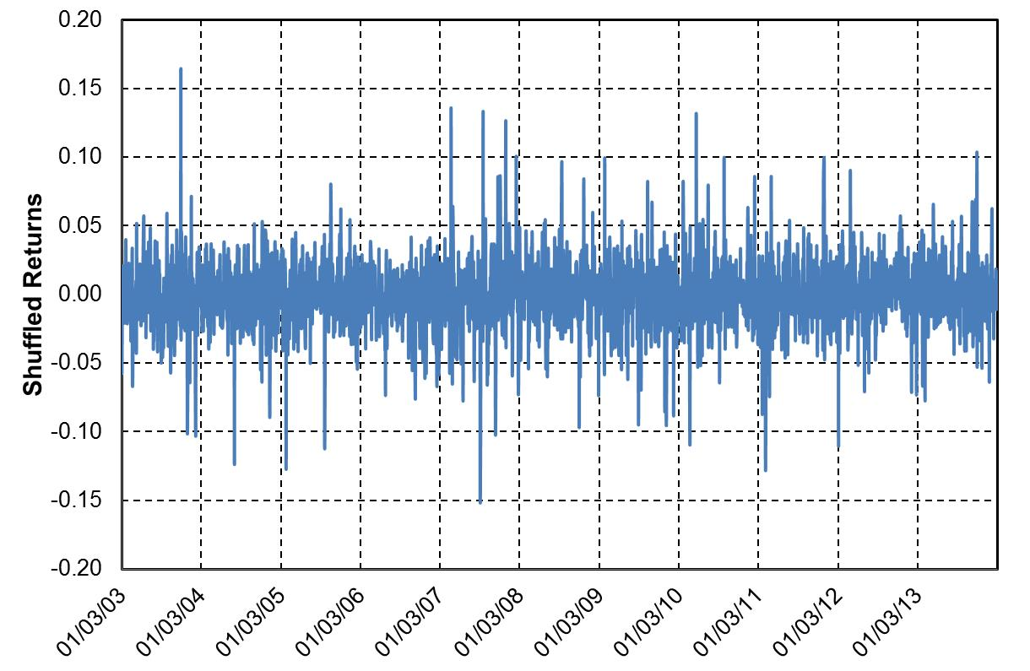
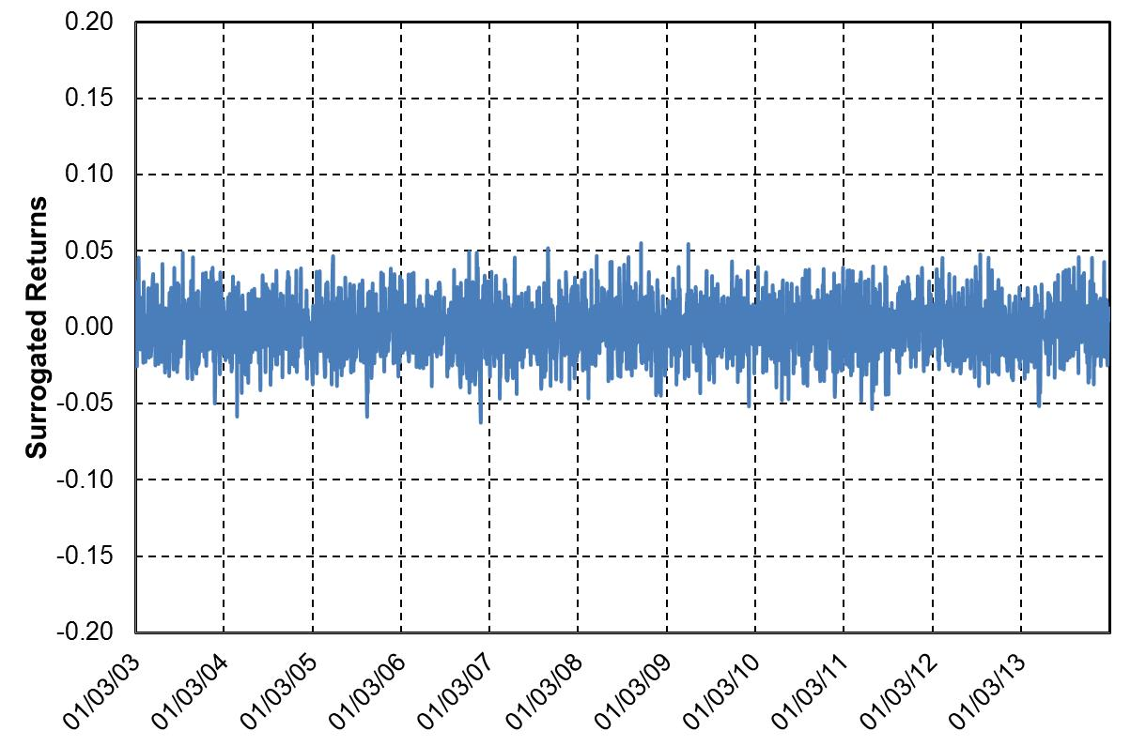
WTI Crude

Slide 39
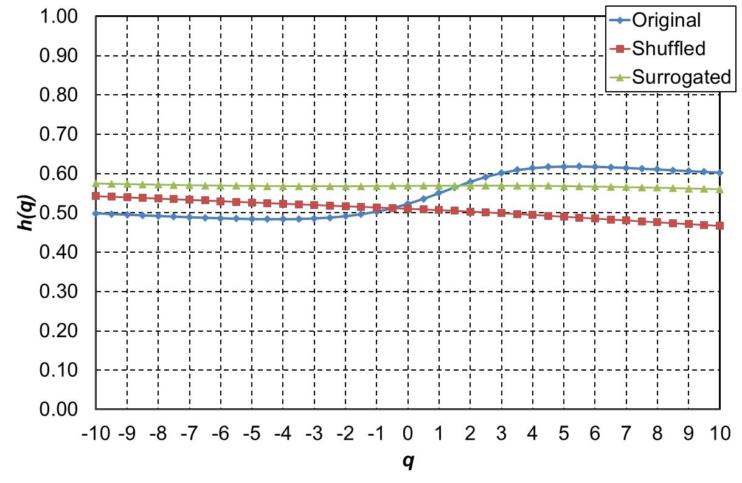
Brent Crude

Slide 40
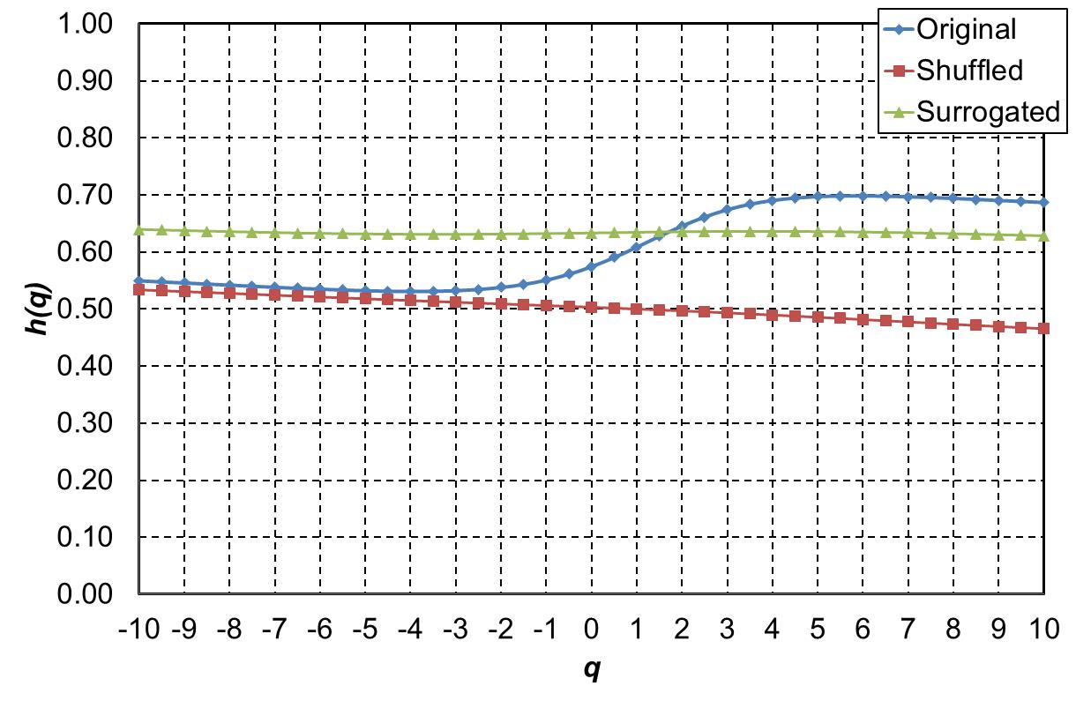
OPEC Reference Basket

Slide 41
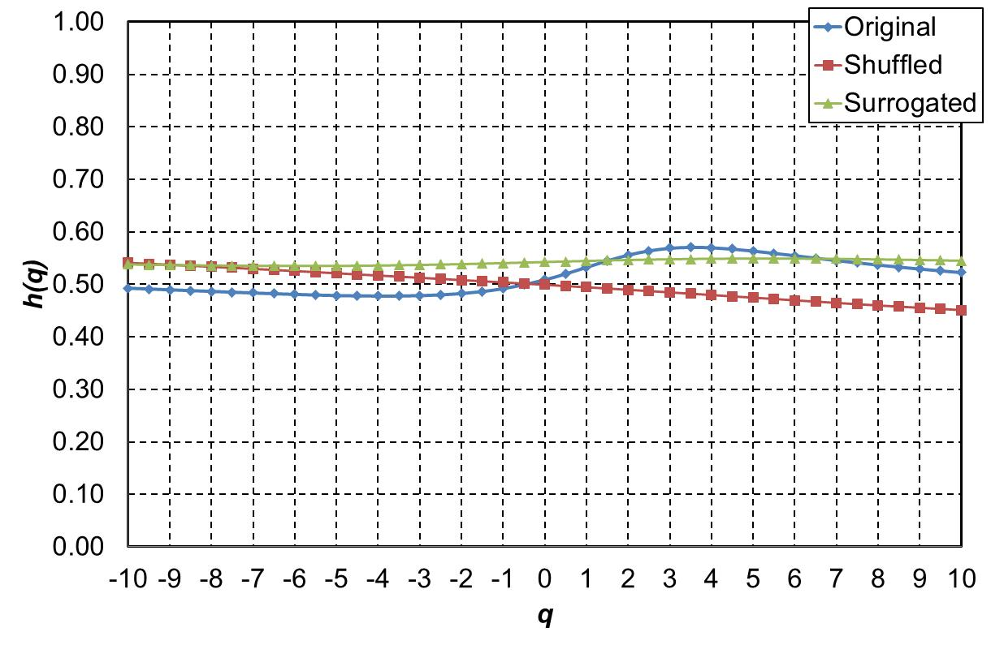
WTI Crude

Slide 42
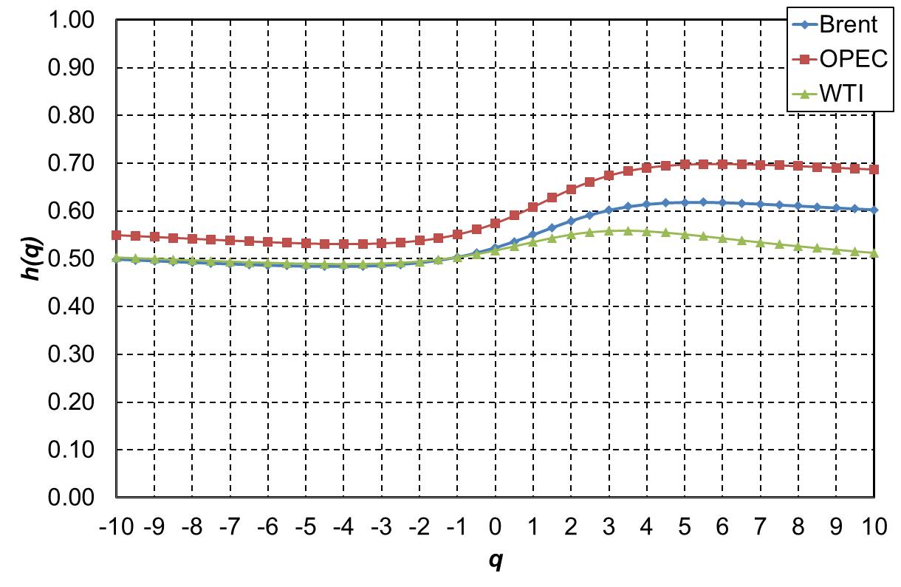

Slide 43
Results
$$q$$ | Brent |  |  | OPEC |  |  | WTI
 | Original | Shuffled | Surrogated | Original | Shuffled | Surrogated | Original | Shuffled | Surrogated
-10 | 0.4991 | 0.5427 | 0.5750 | 0.5496 | 0.5337 | 0.6397 | 0.4928 | 0.5410 | 0.5380
-9 | 0.4974 | 0.5412 | 0.5742 | 0.5477 | 0.5322 | 0.6387 | 0.4913 | 0.5393 | 0.5375
-8 | 0.4957 | 0.5397 | 0.5734 | 0.5458 | 0.5307 | 0.6377 | 0.4897 | 0.5374 | 0.5369
-7 | 0.4940 | 0.5381 | 0.5727 | 0.5439 | 0.5291 | 0.6367 | 0.4882 | 0.5355 | 0.5365
-6 | 0.4923 | 0.5365 | 0.5720 | 0.5420 | 0.5276 | 0.6358 | 0.4867 | 0.5336 | 0.5361
-5 | 0.4907 | 0.5349 | 0.5713 | 0.5401 | 0.5260 | 0.6350 | 0.4852 | 0.5316 | 0.5357
-4 | 0.4892 | 0.5333 | 0.5707 | 0.5382 | 0.5244 | 0.6342 | 0.4837 | 0.5296 | 0.5354
-3 | 0.4878 | 0.5316 | 0.5702 | 0.5365 | 0.5228 | 0.6334 | 0.4823 | 0.5276 | 0.5353
-2 | 0.4865 | 0.5300 | 0.5697 | 0.5349 | 0.5212 | 0.6328 | 0.4810 | 0.5255 | 0.5352
-1 | 0.4854 | 0.5284 | 0.5692 | 0.5334 | 0.5197 | 0.6322 | 0.4798 | 0.5234 | 0.5352
0 | 0.4846 | 0.5268 | 0.5689 | 0.5322 | 0.5181 | 0.6318 | 0.4788 | 0.5213 | 0.5353
1 | 0.4841 | 0.5251 | 0.5686 | 0.5313 | 0.5165 | 0.6315 | 0.4781 | 0.5191 | 0.5356
2 | 0.4841 | 0.5235 | 0.5684 | 0.5309 | 0.5150 | 0.6312 | 0.4778 | 0.5170 | 0.5360
3 | 0.4846 | 0.5219 | 0.5682 | 0.5312 | 0.5135 | 0.6311 | 0.4779 | 0.5148 | 0.5365
4 | 0.4860 | 0.5203 | 0.5681 | 0.5322 | 0.5120 | 0.6312 | 0.4786 | 0.5127 | 0.5371
5 | 0.4883 | 0.5187 | 0.5681 | 0.5343 | 0.5105 | 0.6313 | 0.4801 | 0.5105 | 0.5378
6 | 0.4917 | 0.5171 | 0.5682 | 0.5379 | 0.5091 | 0.6316 | 0.4826 | 0.5083 | 0.5387
7 | 0.4967 | 0.5156 | 0.5683 | 0.5432 | 0.5076 | 0.6320 | 0.4864 | 0.5061 | 0.5396
8 | 0.5034 | 0.5140 | 0.5685 | 0.5508 | 0.5062 | 0.6324 | 0.4919 | 0.5038 | 0.5406
9 | 0.5122 | 0.5123 | 0.5687 | 0.5611 | 0.5047 | 0.6329 | 0.4993 | 0.5016 | 0.5416
10 | 0.5231 | 0.5107 | 0.5689 | 0.5743 | 0.5032 | 0.6335 | 0.5087 | 0.4993 | 0.5427
$$∆h$$ | 0.5360 | 0.5090 | 0.5691 | 0.5904 | 0.5017 | 0.6341 | 0.5200 | 0.4970 | 0.5437
 |  | $h_{c}$= -0.1787 | $h_{d}$= -0.1179 |  | $h_{c}$= -0.2053 | $h_{d}$= -0.1485 |  | $h_{c}$ = -0.1195 | $h_{d}$= -0.0226

Slide 44
Conclusions
The study concludes that
Among the three major international crude oil markets under the study, WTI is the most efficient while OPEC is the most inefficient, and
for the three markets, the multifractality is mainly due to long-range correlation.

Slide 45
Thank you!

